Slide 1
JS
AXIOS
How to request APIs

Slide 2
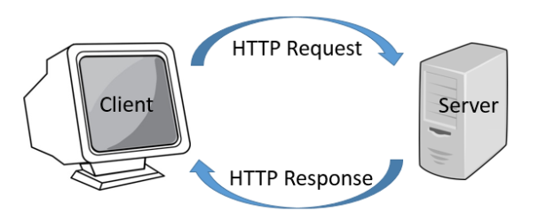
REMINDER
HTTP is the format used to structure request and responses on communication between a client and a server
Notes:
Go fast on reminders

Slide 3

REMINDER
In Javascript we use Axios to send an HTTP request and handle their responses,
Notes:
Go fast on reminders

Slide 4

OBJECTIVES
Understand what is an API and how to use them
Understand the anatomy of an HTTP request
Be able to define requests

Slide 5



REMINDER
On your website, you can ask
a web service to help you
REQUEST
RESPONSE
(FRONT )
WEB SERVICE !

Slide 6

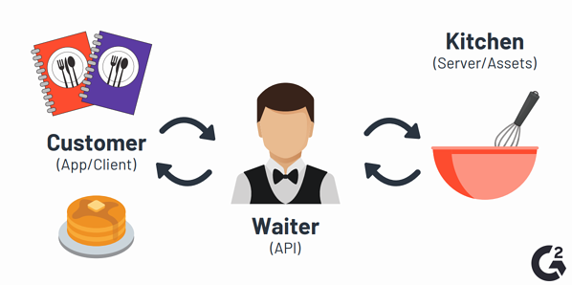
What is an API ?
THE MENU OF THE SERVICES
Web Service
Notes:
Your app asks the API (which has a menu, list of requests), for the service they can use in the kitchen.

Slide 7
A web API (Application Programming Interface)
Gives you the menu :
Endpoints (URL) to send requests to web service
parameters to specify for each request
WEB API
https://www.smashingmagazine.com/tag/javascript/?query1=value1&query2=value2
Root-endpoint
= host of server
+
Path
PARAMETERS
= ENDPOINT
Notes:
A web API is a set of specifications on How to use a web service
The Root Endpoint is the starting point.
The Path is specifying the ressource you are asking for.

Slide 8

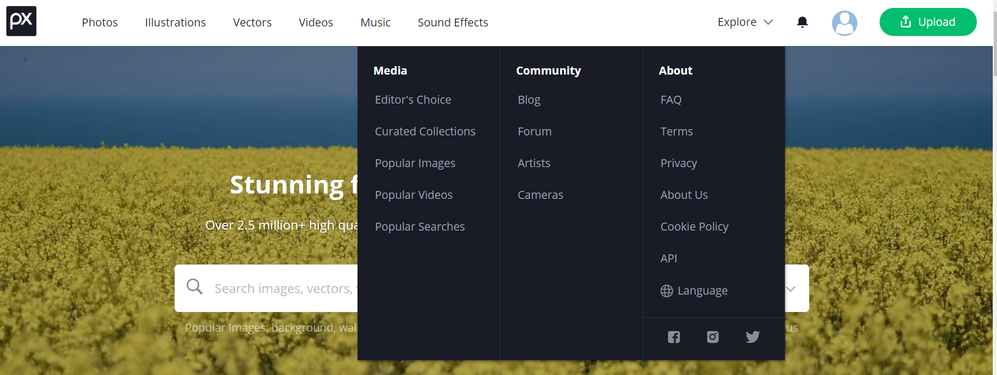
EXPLORE
ACTIVITY 1
10 MIN
Example of API : pixabay
1 – Go to https://pixabay.com/
2 – What are the web services available ? What are their endpoints ?
3 – What are the parameters, and their roles ?
Notes:
http://www.omdbapi.com/

Slide 9
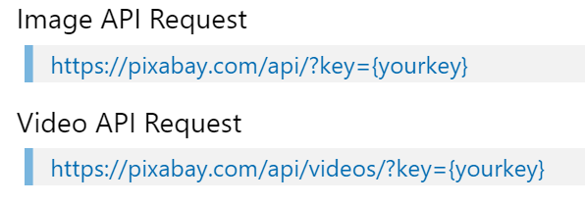
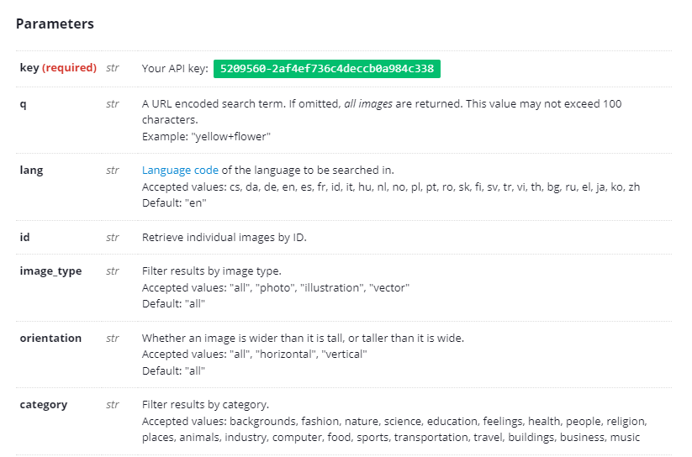
Example of API : omdbapi
Service 1 : movies
Endpoints
Service 2 : posters
Parameters and roles …

Slide 10
A special parameter : the API key
API key
Notes:
Maybe they noticed this.
Private API will have a private key, public ones will usualy have a manual generation and a restriction of use.
WHY :
Because it’s expensive to run a web service
Because maybe the API gives access to private information

Slide 11
PRACTICE
ACTIVITY 2
10 MIN
Find the URL !
Send in message to the conversation, what is the corresponding URL
for each service ! The first who is correct wins the point !
QUERY | URL
1- Get info of « Flower » | 1: https://pixabay.com/api/?key=[your_key]&q=flower
Get ready !

Slide 12
PRACTICE
ACTIVITY 2
10 MIN
Find the URL !
Send in message to the conversation, what is the corresponding URL
for each service ! The first who is correct wins the point !
QUERY | URL
1- Get all info of « Food»
2- Get all flower with yellow color

Slide 13
PRACTICE
ACTIVITY 3
20 MIN
Instructions are in the code
Notes:
http://www.omdbapi.com/
What is it ?
-> list of possible requests
-> list of parameters to put in the URL
-> returns data

Slide 14

Anatomy of a request
What is inside ?
Who sends it ?
Is it authorized ? (key)
Header
Delivery Address
= URL
Sometimes parameters are
in the URL instead of header/body
Body
Only for Post/Put
The data you send (usually JSON or XML)
Notes:
If the header is bad, sometimes the request is refused !
The definition of what is inside the body, what is inside the header depends of the API !
REMARK : a body only exists in POST/PUT requests, or response from server. A GET request does not have a body (no data transfere)

Slide 15
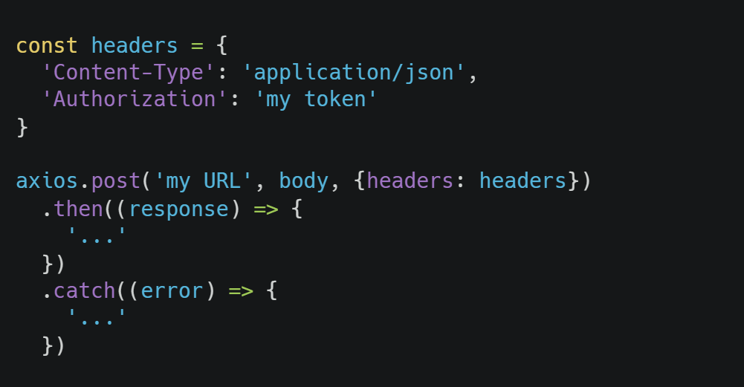
With Axios :
Define the header object
Give body and header to axios

Slide 16

What about HTTP errors ?

Slide 17
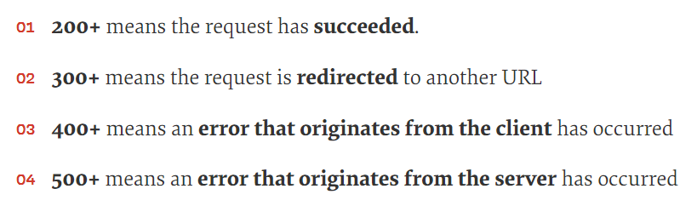
Read the STATUS
Every request returns a status code
Your request is wrong !
Notes:
If the request is wrong, check the header, check the body, check the URL…
Requests : https://developer.mozilla.org/en-US/docs/Web/HTTP/Status

Slide 18
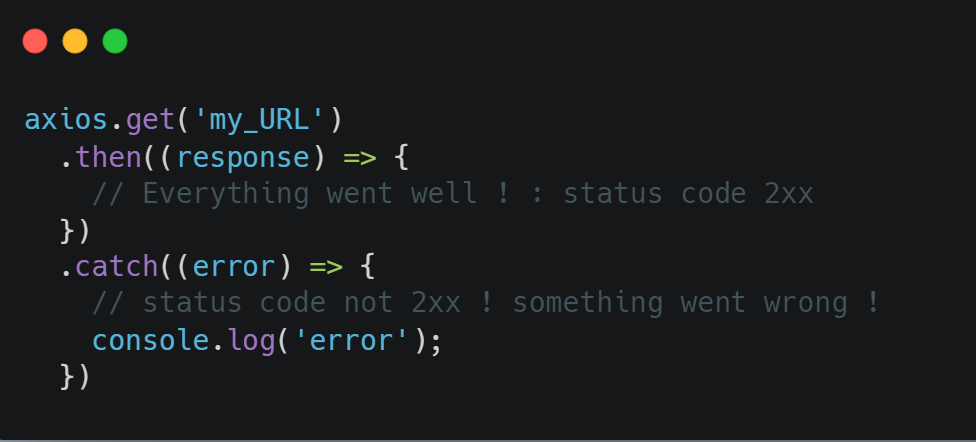
Axios error handling :
Status code 2xx
Not 2xx
Note : in case of error, maybe there is still something in “error.response” !
Notes:
Axios reads the status, and executes the corresponding code depending of the status.
If there is something in error.response, it means the request reached the server and came back, but something weird happened.

Slide 19
NOW YOU KNOW
What an API is, and how to use it
How is made an HTTP request, and how to define it
How to use AXIOS in a Javascript projects to execute HTTP requests and use web services !
Have fun practicing with fun API online !

Slide 20
Useful links :
List of HTTP status codes:
https://developer.mozilla.org/en-US/docs/Web/HTTP/Status
• list of public API you can use : https://mixedanalytics.com/blog/list-actually-free-open-no-auth-needed-apis/
• Request bin online :
https://requestbin.com/

